Slide 1
Unplanned Issue

Slide 2
Project Status
User Testing and Acceptance
Put live

Slide 3
Operation Procedure
PMC
  Lock Material for Unplanned Issue
  Create UPI Form
  Input Reason into Notepad
  Confirm UPI
  Print UPI Form
Warehouse
  Execute UPI
  Lot Enquiry to verify okay
Amy Yip
  Print Notepad Listing for weekly review

Slide 4
Lock Material for Unplanned Issue
Check for available materials
Materials reserved / locked for IDO / UPI are excluded

Slide 5
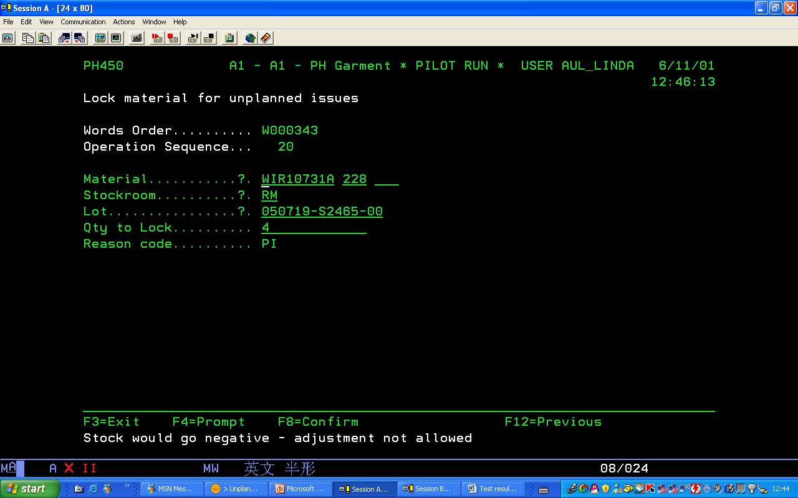

Slide 6


Slide 8
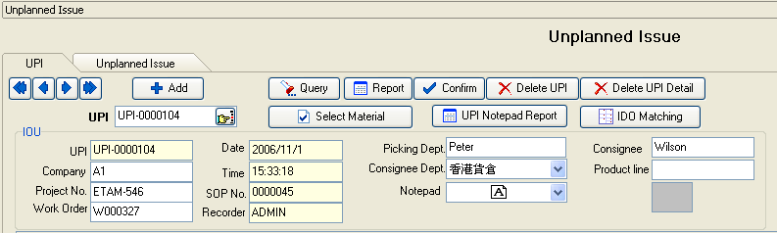
Create UPI Form

Slide 9
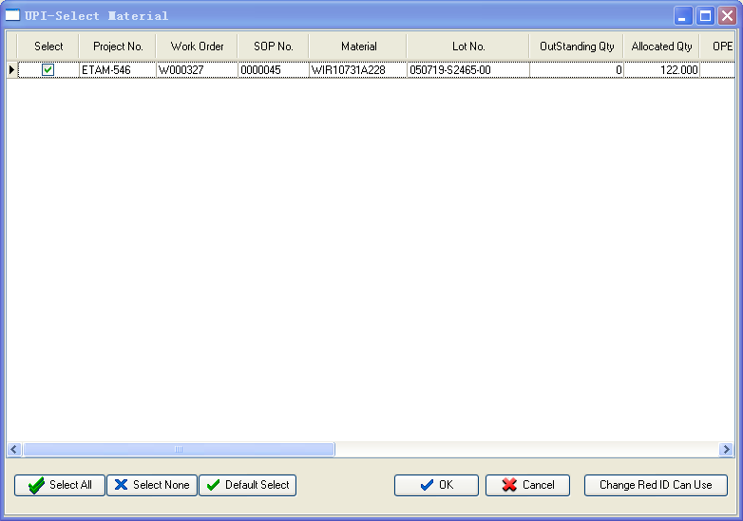
Select Material

Slide 10
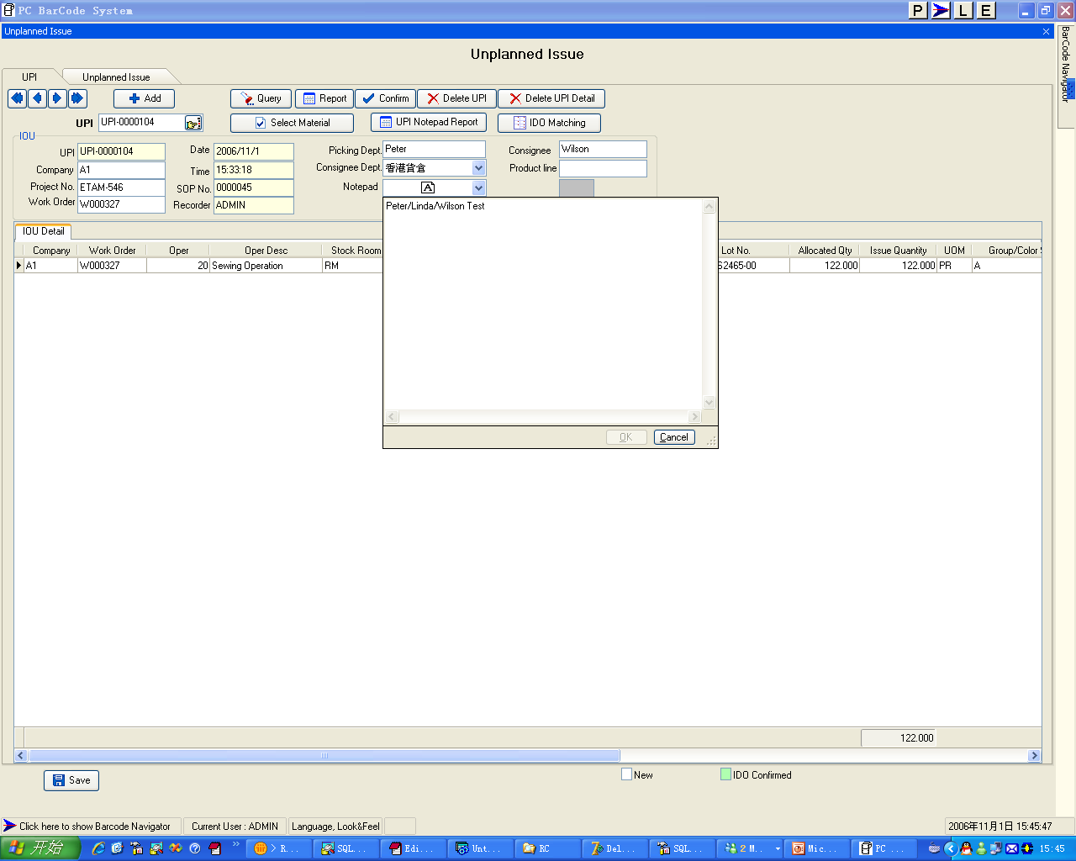
Input Reason into Notepad

Slide 11
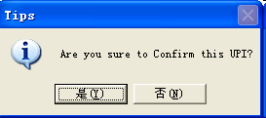
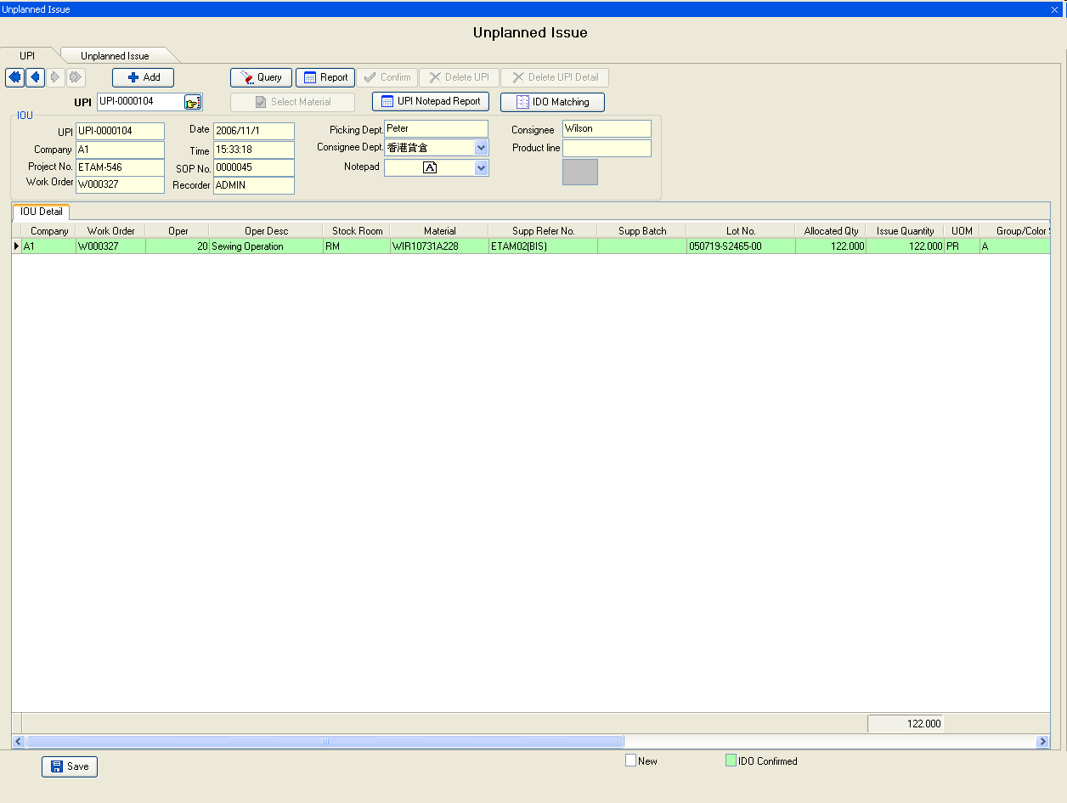
Confirm UPI

Slide 12
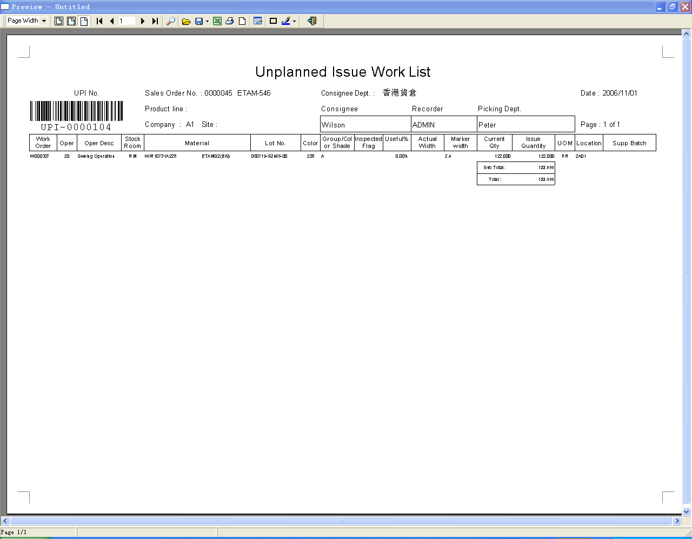
Print UPI Form

Slide 13
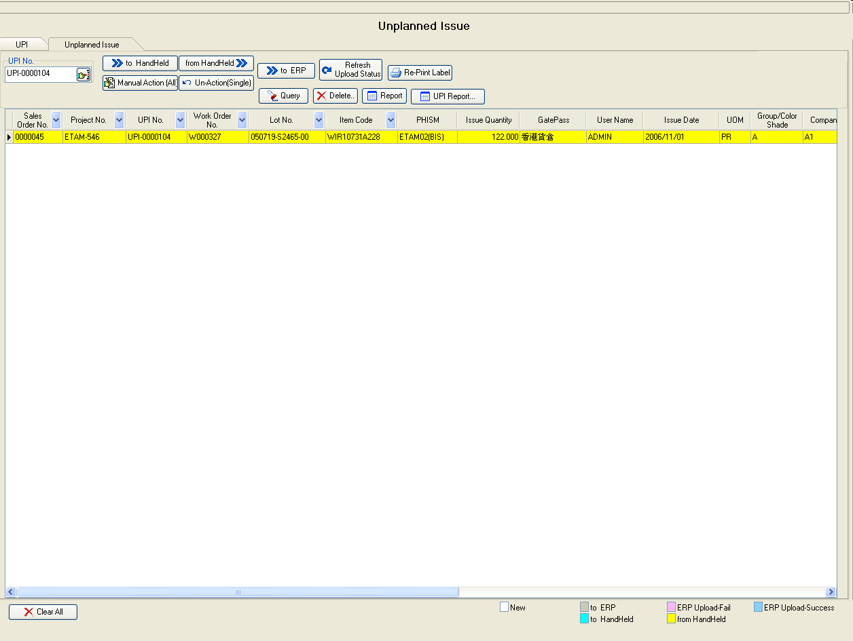
Execute UPI(1)

Slide 14
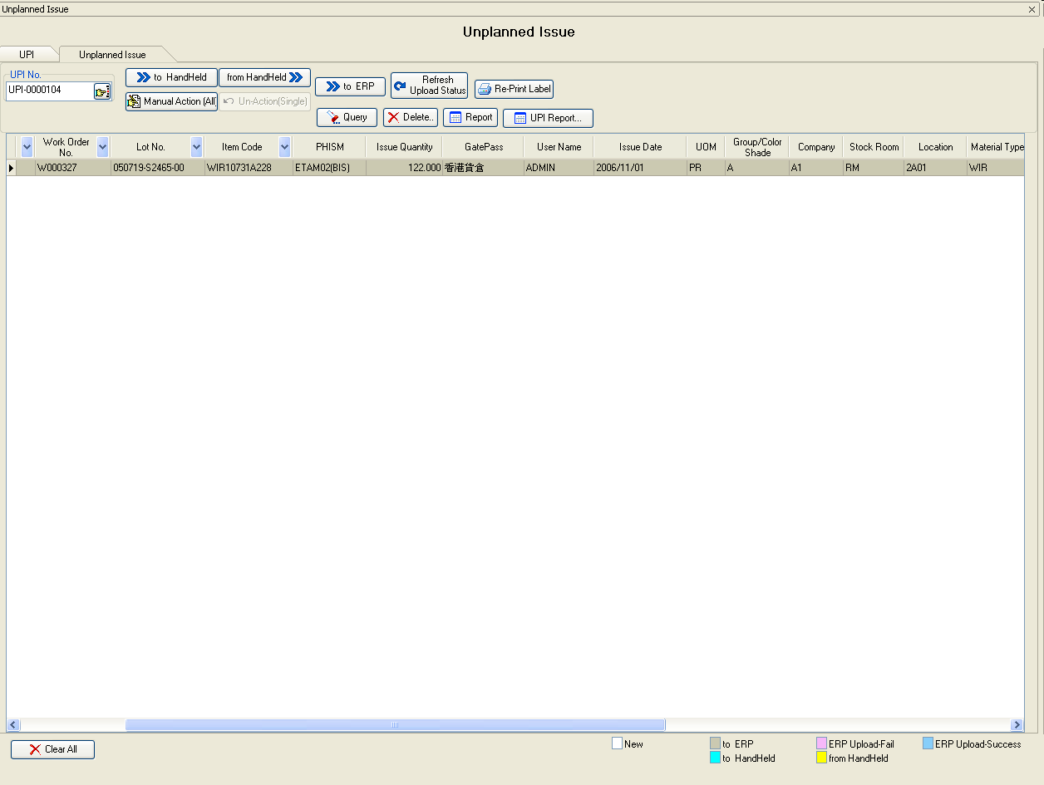
Execute UPI (2)

Slide 15
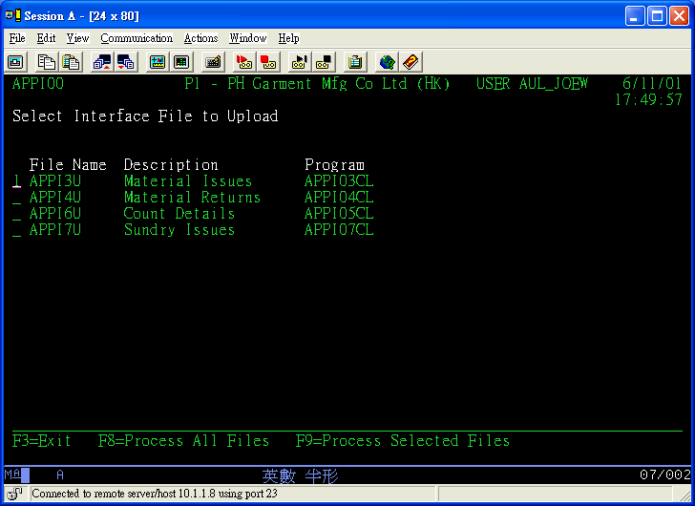
Execute UPI (3)

Slide 16
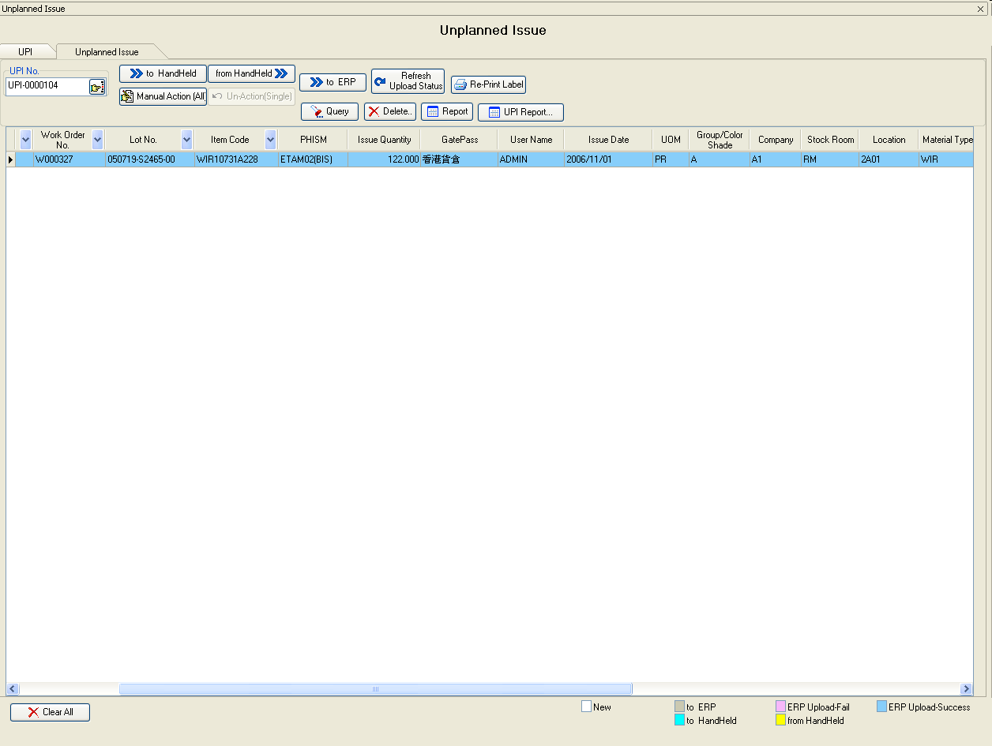
Execute UPI (4)

Slide 17
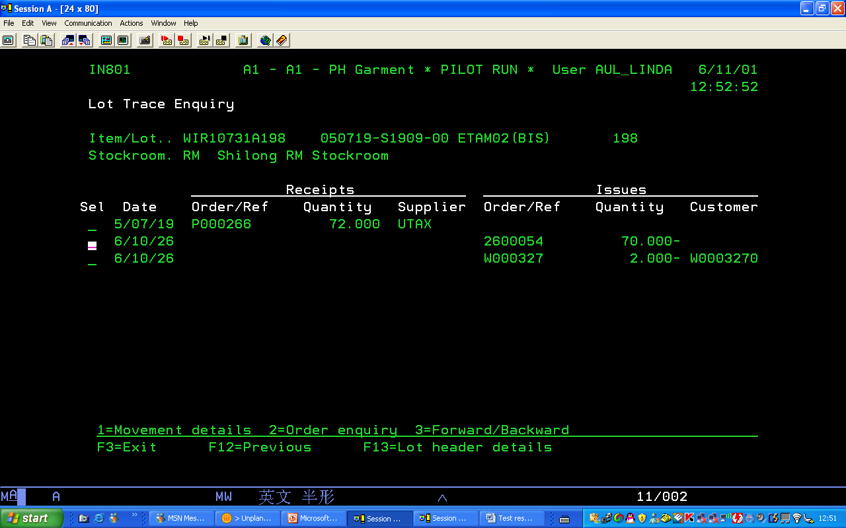
Lot Enquiry to verify okay

Slide 18
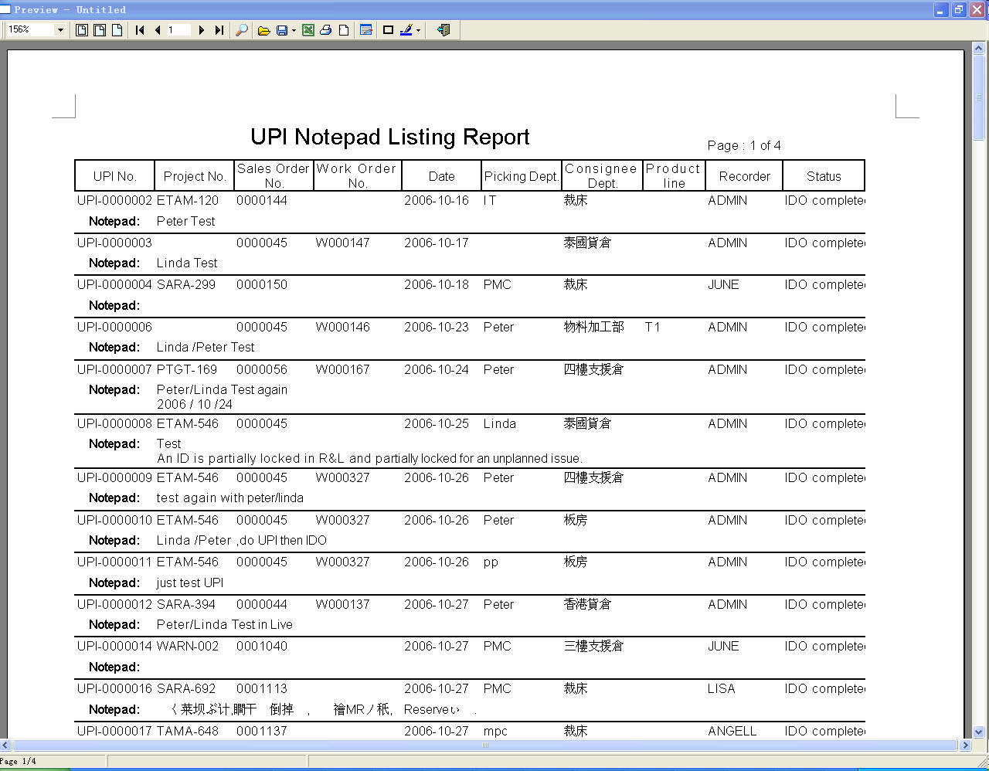
Print Notepad Listing for weekly review

